Slide 1
Micro-Credit Defaulter Model
Prediction of Micro-Credit Defaulter based on data
from mobile financial services (MFS)
Submitted By-
Madhurima Srivastava
Internship-30

Slide 2
Review of Literature
This paper provides a systematic assessment of customer behavior and the trend of loan taken Vs loan paid back to the Microfinance Institution (MFI) in Indonesia bases on the above given factors. From our analysis and research done one can understand that depending on what factors customers are ending up on being a defaulter, using this study a Microfinance Institution (MFI) can predict that a customer can be a defaulter or not basis on which Microfinance Institution (MFI) can confer short-term loans.
Further our study helps the Micro finance institution to understand, analysis and predict the futuristic behavior of a customer that could help them in further speculation and improvement in selection of customers.

Slide 3
About Microfinance Institution
A Microfinance Institution (MFI) is an organization that offers financial services to low-income populations. MFS becomes very useful when targeting especially the unbanked poor families living in remote areas with not much sources of income. The Microfinance services (MFS) provided by MFI are Group Loans, Agricultural Loans, Individual Business Loans and so on.

Slide 4
Prediction of Micro-Credit Defaulter
Problem statement
EDA steps and visualizations
Steps and assumptions
Model dashboard
Finalized model
Conclusion

Slide 5
Problem statement
Build a model using the best machine learning algorithm which can be used to predict in terms of a probability for each loan transaction, whether the customer will be paying back the loaned amount within 5 days of insurance of loan. In this case, Label ‘1’ indicates that the loan has been paid i.e., Non- defaulter, while, Label ‘0’ indicates that the loan has not been paid i.e., defaulter

Slide 6
EDA steps and visualizations
Deleting the duplicate records.
Deleting the irreverent data and columns.
Splitting date columns into machine Learning understandable format.
Removing Skewness and outliers.

Slide 7
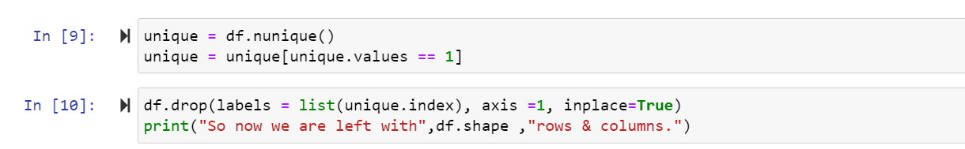
Deleting the duplicate records.
The first step of EDS started with cleansing the data with removing the duplicate records since duplicate records reduces the performance of the model.

Slide 8
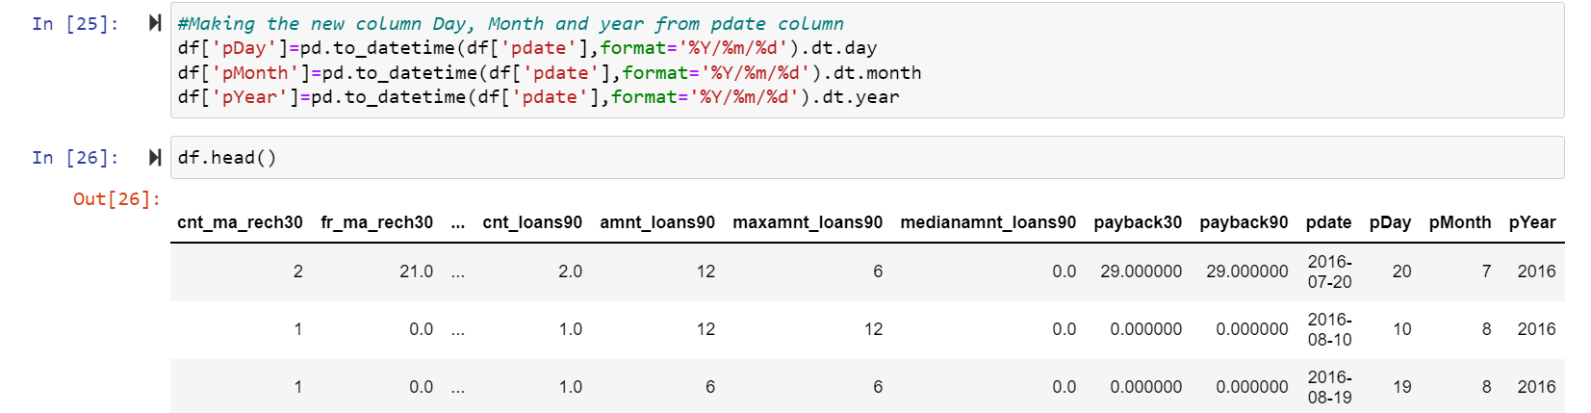
Splitting Date columns into machine Learning understandable format.
From the given data I have observed that data is taken from year 2016 and mostly of 06th, 07th, 08th months and I have split the ‘pdate’ columns into ‘pdate_day’ and ‘pdate_month’ to reduce the complexity and dropped ‘pdate’.

Slide 9
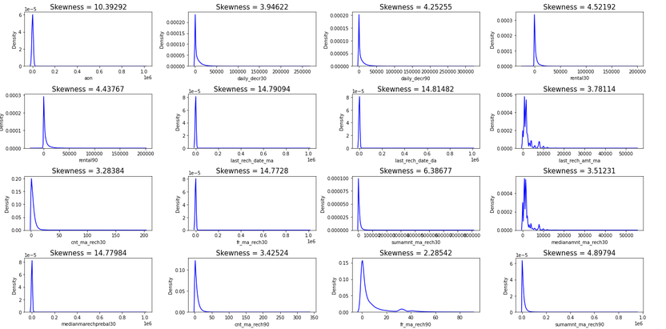
Removing Skewness and outliers.
The data is observed to have extreme positive skewness.
The sample of data is displayed we will correct the skewness by Power transformation method.

Slide 10
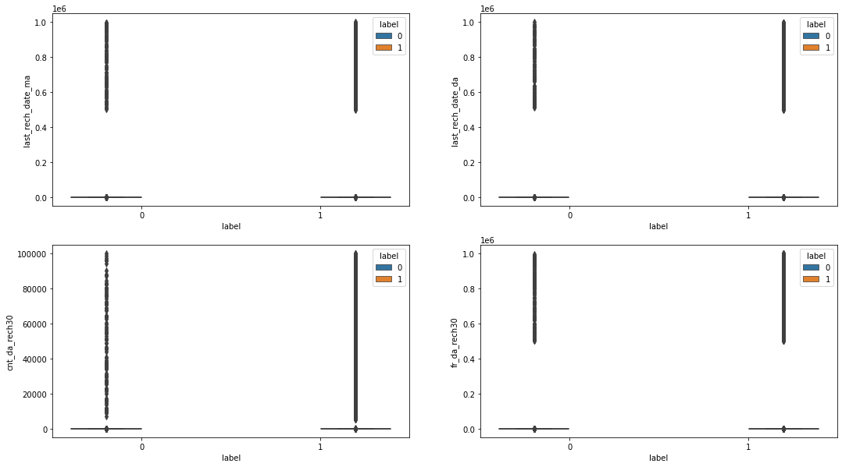
Outliers
Data seems to have too many outliers removal of outliers will deform the data and we will loose more data. So I have decided to work with outliers

Slide 11
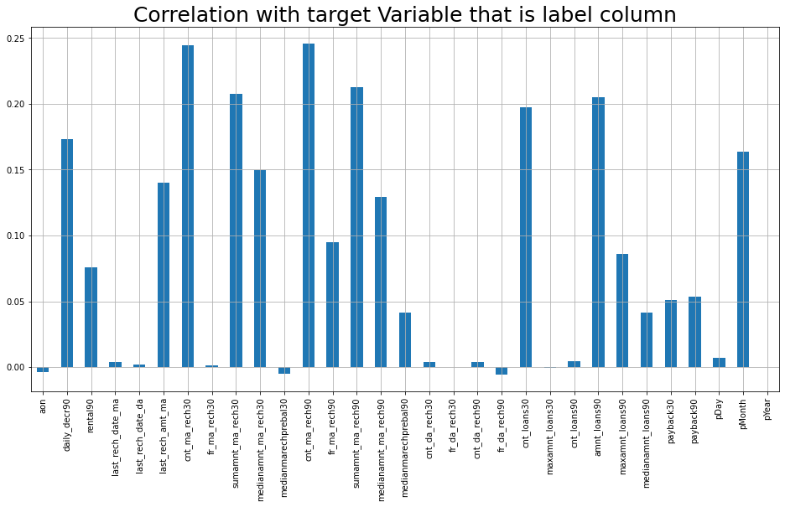
Visualizations Data insights
Here we see the correlation of the columns with respect to the target column that is label.

Slide 12
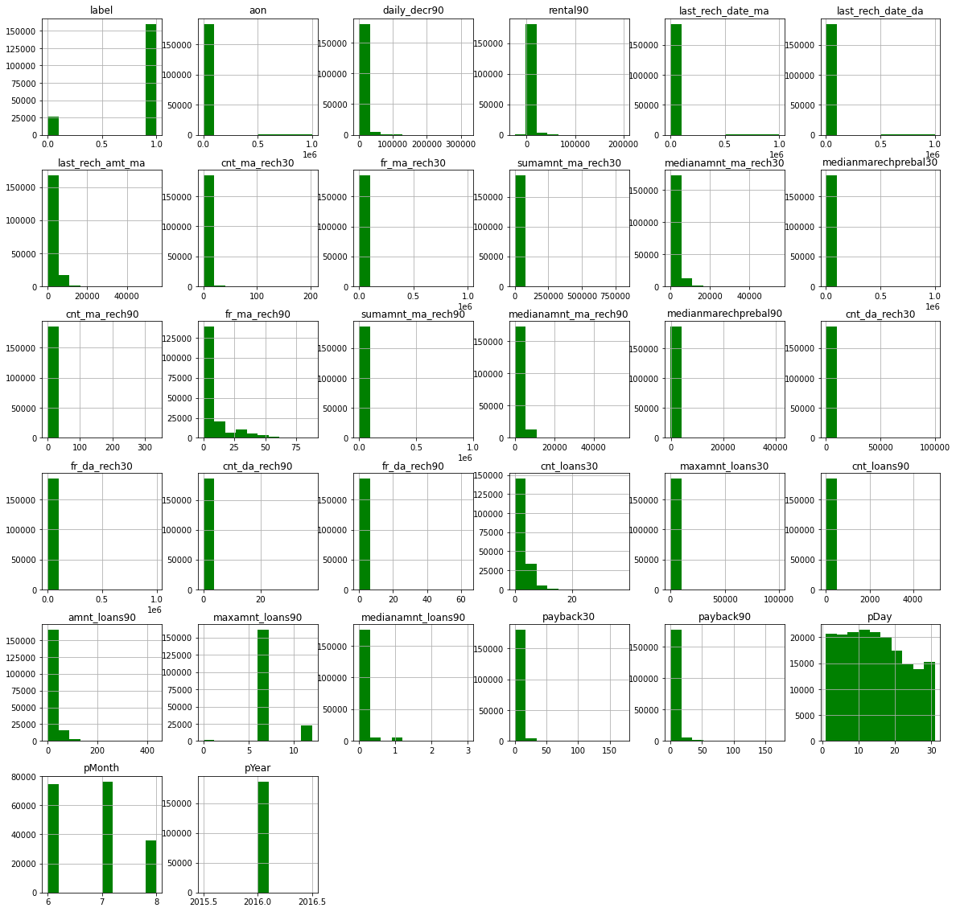
Plotting the Histogram
We plot the histogram to display the shape and spread of continuous sample data.In a histogram, each bar groups numbers into ranges. Taller bars show that more data falls in that range

Slide 13
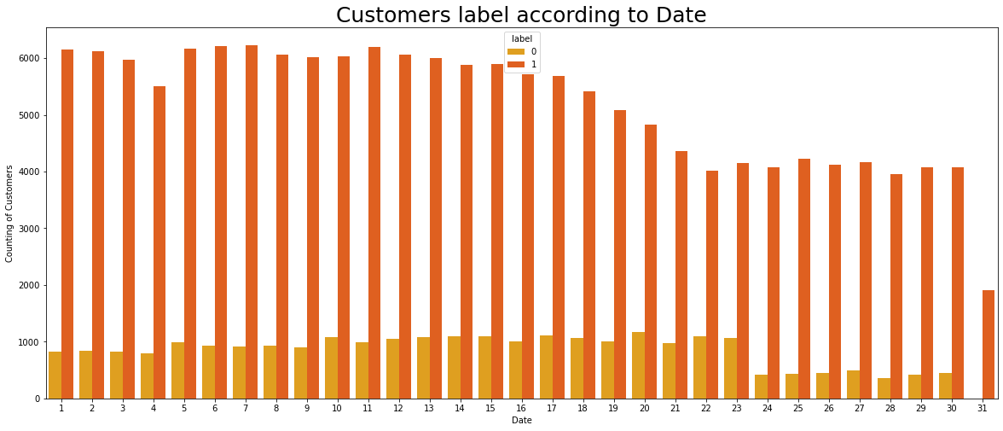
Customer label according to Date
The first figure which is date vs label shows that the customers who did not pay their loans are from date 10 to 23.
There are severals customers at June and July month who did not pay their loan.

Slide 14
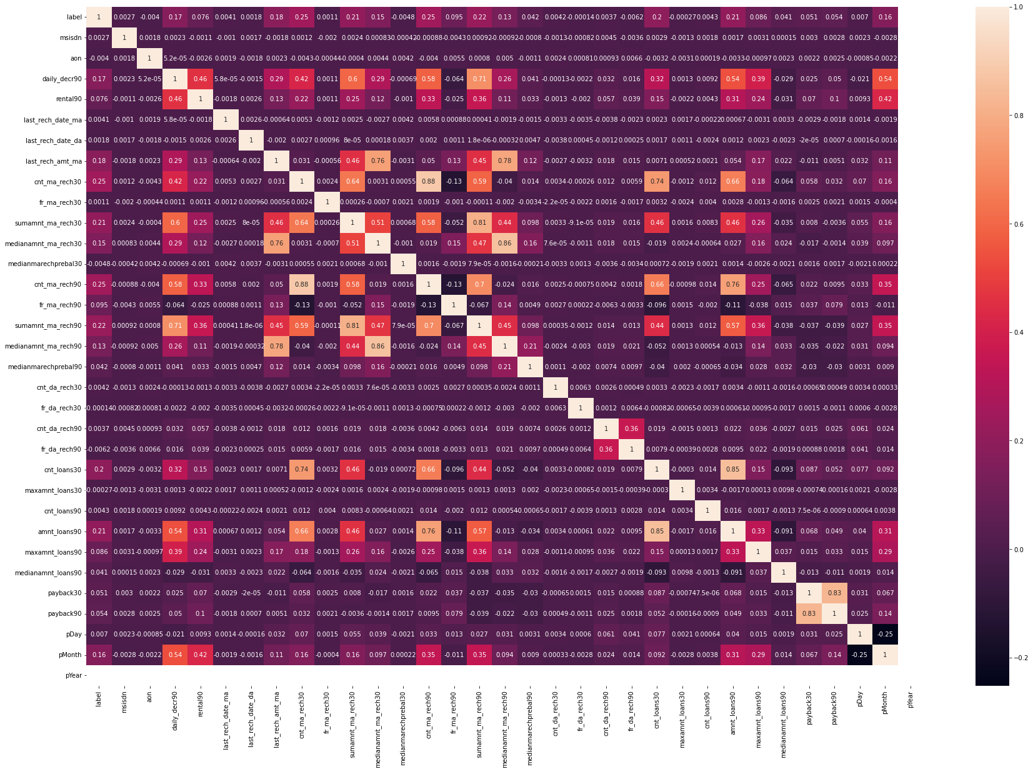
Correlation Visualizations.
daily_decr30 and daily_decr90 features are highly correlated with each other.
rental30 and rental90 features are highly correlated with each other.
cnt_loans30 and amount_loans30 columns are highly correlated with each other.

Slide 15
Correlation only with Target Variable
Key Observations:
From above we can observe that "cnt_ma_rech30", "cnt_ma_rech90", "sumamnt_ma_rech90", "sumamnt_ma_rech30" have more correlation with the Target variable "label".
We have more positive correlated variable than the negative correlated variable.

Slide 16
Steps and Assumptions.
With all the insights taken we have plotted few pre-assumptions which are as follows.
As like said above Label ‘1’ indicates that the loan has been paid i.e., Non- defaulter, while, Label ‘0’ indicates that the loan has not been paid i.e., defaulter.
daily_dec30, daily_dec90, rental30, rental90, cnt_da_rech30, sumamnt_ma_rech30, cnt_ma_rech90, sumamnt_ma_rech90, medianmarechprebal90, cnt_da_rech90, cnt_loans30, amnt_loans30, amnt_loans90, the above columns have more contributions in 0 that is defaulter, which means that customer have more contributions on above factors end up as defaulter.
aon, last_rech_date_ma, last_rech_date_da, fa_ma_rech30, medianmarechprebal30, medianamnt_ma_rech90, cnt_da_rech30, fr_da_rech30, maxamnt_loan30, cnt_loans90 have more contributions in 1. which means that customer have more contributions on above factors end up as not a defaulter.
payback90, payback30, medianamnt_loans90, fr_da_reach90, medianamnt_ma_reach90, medianamnt_ma_reach30, last_rech_amt_ma almost have equal contributions in 0 and 1.

Slide 17
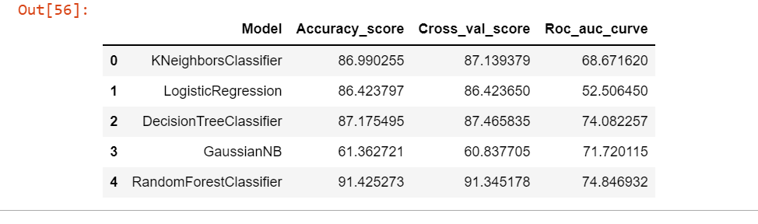
Model Dashboard
We have trained our model based on five different Classification algorithm and have shortlisted the best algorithm with metrics as follows.

Slide 18
Conclusion
Key Findings and Conclusions of the Study
From our above analysis we understand that which factors are responsible and using which a Microfinance Institution (MFI) can predict that a customer can be a defaulter or not a defaulter basis on which Microfinance Institution (MFI) can give a short-term loan and predictions that could help them in further investment and improvement in selection of customers.
Limitations of this work and Scope for Future Work
Limitations of the study arise from the use of a single dataset obtained from one company. However, the large number of loans and customers considered and generic applicability of credit scoring for mobile credit suggests that the variables and models investigated are relevant for other business applications. Further work may include the use of demographic information which could be obtained from mobile network operators and consideration of additional pay-as-you-go mobile products.

Slide 19
THANK YOU

